Slide 1
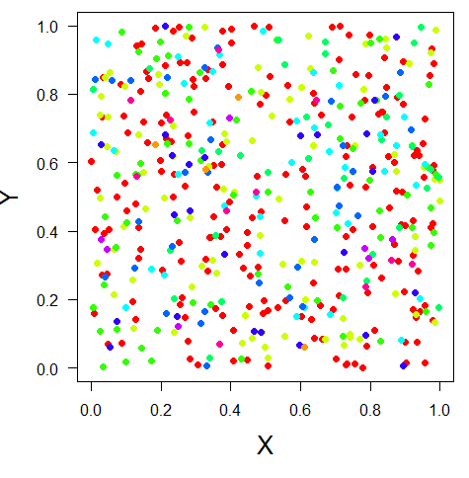
Any measure of diversity only captures part of the picture
α, richness, evenness, diversity entropy
β, similarity, distance decay
γ, SAR, EAR, etc

Slide 2
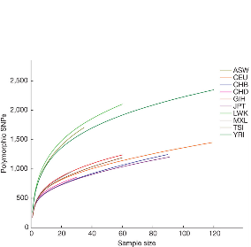
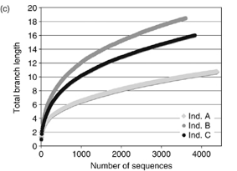
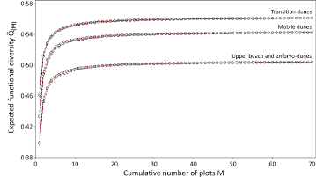
What about other biodiversity facets?
Genetic diversity
Phylogenetic diversity
Functional diversity

Slide 3
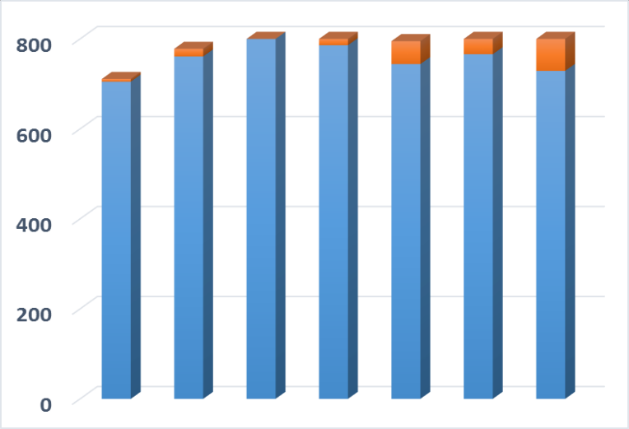
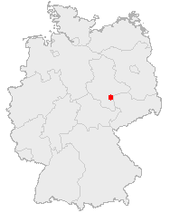
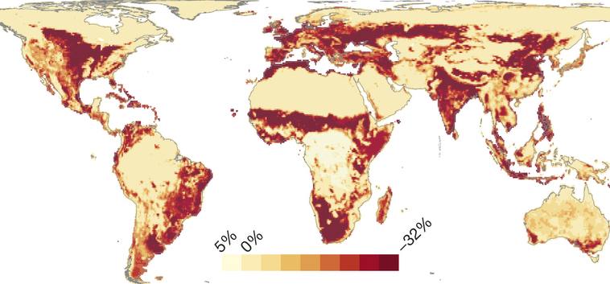
Is there biodiversity loss at smaller scales??
Number of Species
Public Domain, https://commons.wikimedia.org/w/index.php?curid=362363
~1700
1850
1950
~Today
Year
Data from: Knapp, S., et al. 2016. Increasing species richness but decreasing phylogenetic richness and divergence over a 320‐year period of urbanization. Journal of Applied Ecology. doi:10.1111/1365-2664.12826
Reprinted by permission from Macmillan Publishers Ltd: Newbold, T., et al. 2015. Global effects of land use on local terrestrial biodiversity. Nature, 520: 45-50.

Slide 4
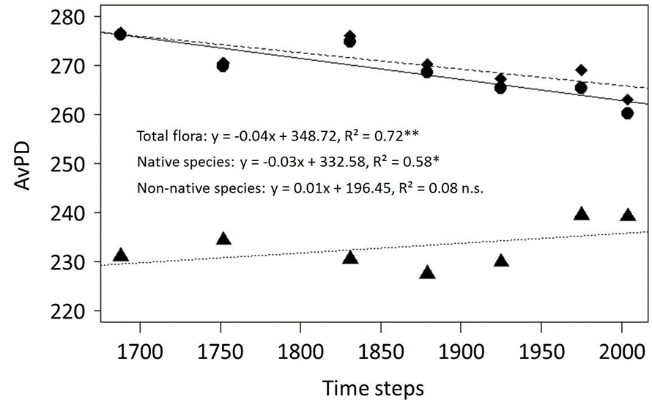
Phylogenetic Diversity
Knapp et al. 2017

Slide 5
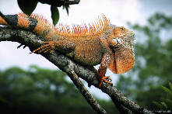
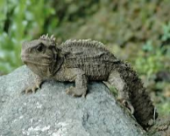
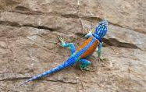
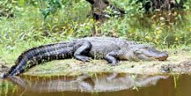
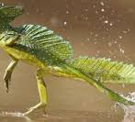
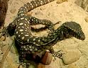
Which community is more diverse?

Slide 6
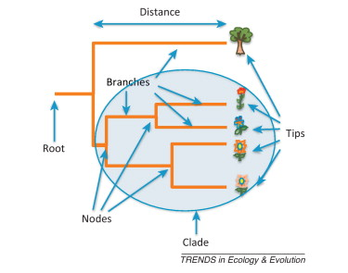
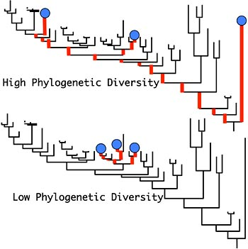
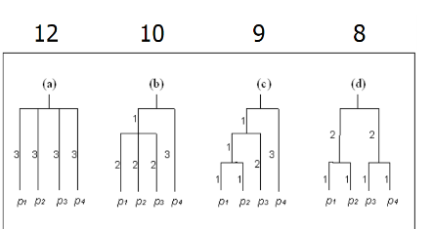
Phylodiversity=sum of branch lengths (Faith 2002)

Slide 7
Metric Choice for Phylogenetic Diversity Matters
Tucker et al. 2016

Slide 8
Tucker et al. 2016

Slide 9
Two main uses of phylogenetic diversity measures
Explore evolutionary patterns (sometimes in the context of conservation)
As ‘proxy’ for niche similarity ideas (e.g., phylogeny ~ function)

Slide 10
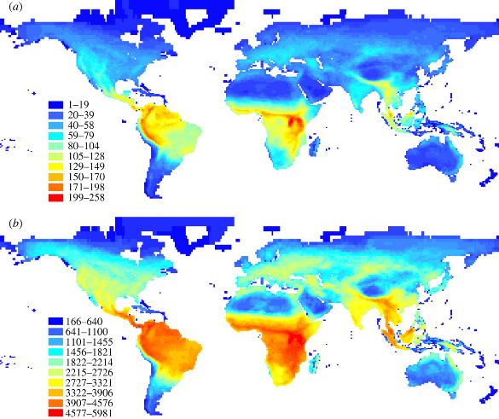
Mammals
—taxonomic diversity
--Phylogenetic
diversity
Davies and Buckley 2011

Slide 11
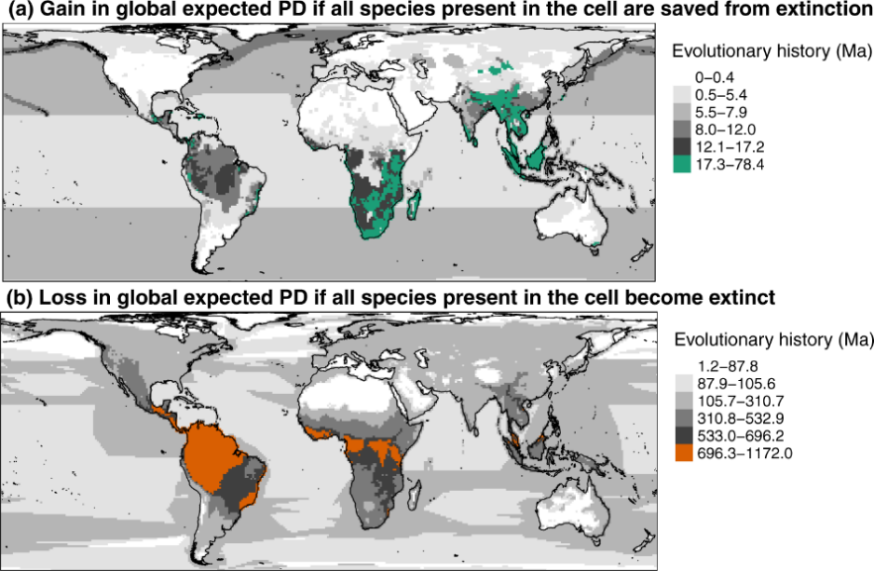
Robuchon et al. 2021 Nature Communications

Slide 12
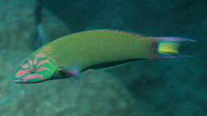
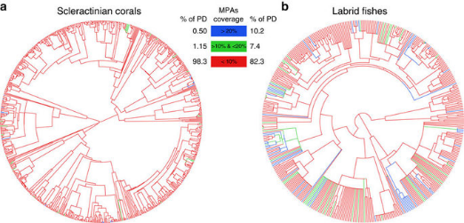
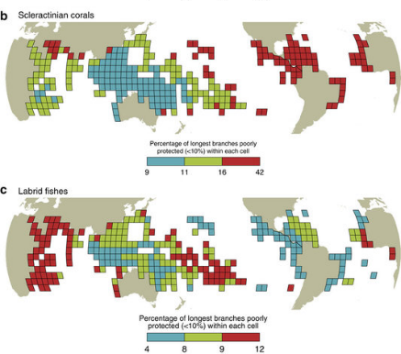
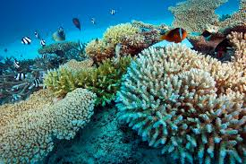
Mouillot et al. 2016

Slide 13
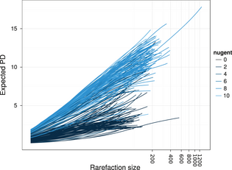
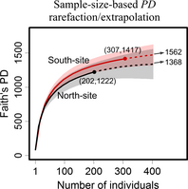
Rarefaction for Phylogenetic Diversity
Nipperess and Matsen 2013
Chao et al. 2015

Slide 14
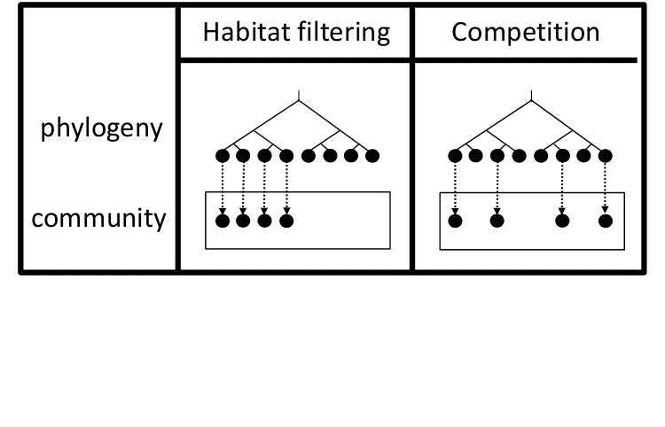
Sometimes we assume phylogeny→trait→interactions….

Slide 15
Over versus under dispersion….

Slide 16
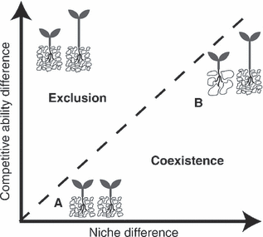
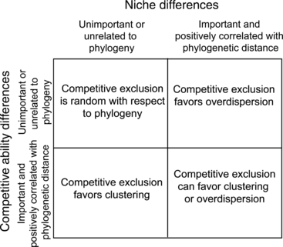
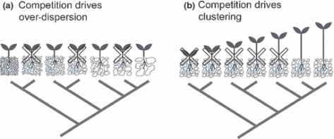
Phylogenetic Coexistence—What Does Theory Predict?
Mayfield and Levine 2010, Ecology Letters

Slide 17
More phylogenetically distant species not more likely to coexist…
…but traits are a better indicator…
Narwani et al. 2013

Slide 18
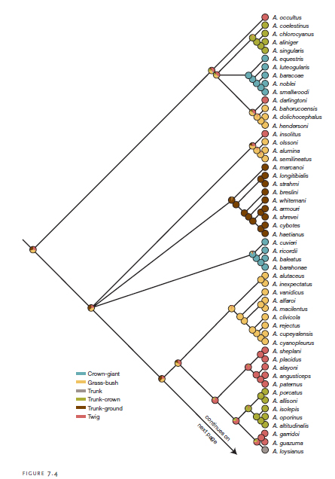
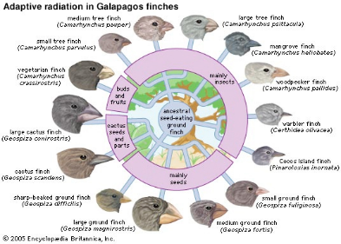
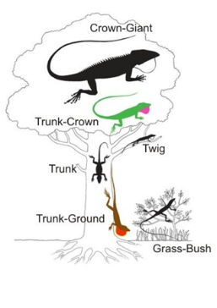
Correlation between traits and phylogenies?
Losos 2005

Slide 19
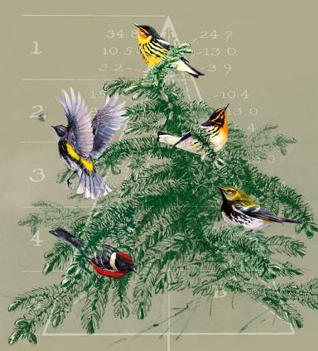
Ecological Niches as the Basis for Coexistence/Diversity
Limiting Similarity (Hutchinsonian ratios)
--Hutchinson 1959
Competition and coexistence
--MacArthur (1958)

Slide 20
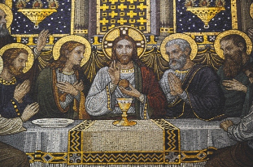
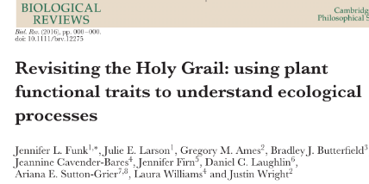

Slide 21


Functional traits
Examples
Plant stature
Seed mass
Leaf area
Pollination syndrome (categorical)
Body size
Beak length
Wing length
Diet (categorical)

Slide 22
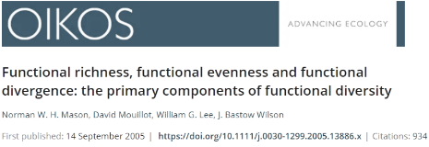
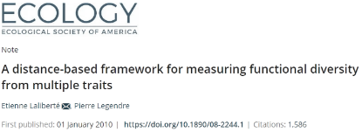

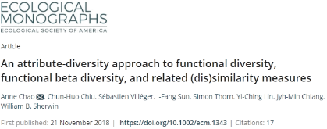
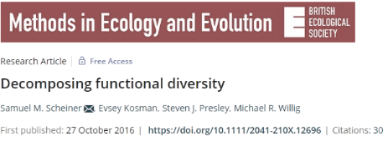
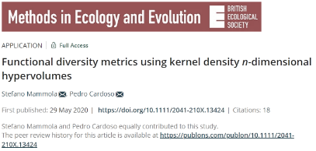
Methods

Slide 23
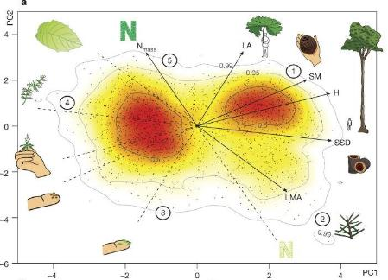
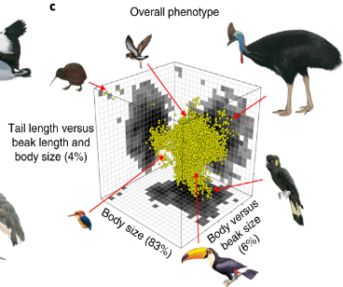
The plant 2D – trait space
The avian 3D - trait space
Díaz et al. 2016. Nature.
Pigot et al 2020. Nature Ecology & Evolution.

Slide 24
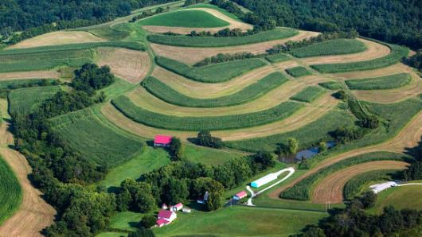
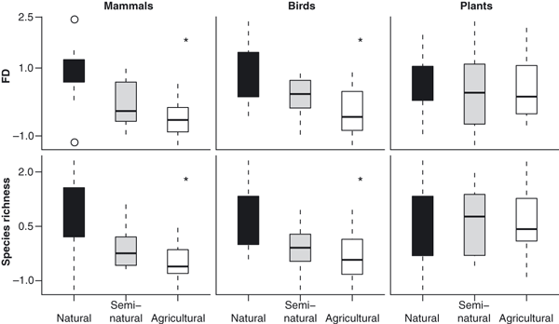
Sometimes Taxonomic and Functional Change in the same direction

Slide 25
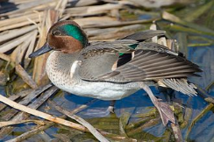
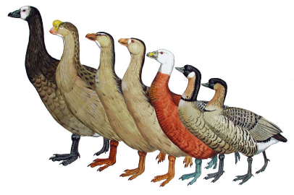
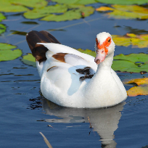
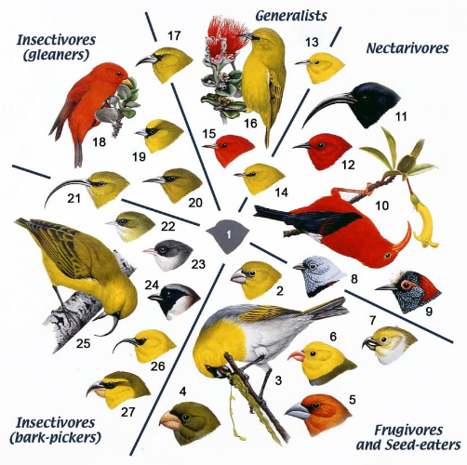
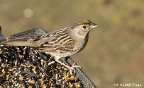
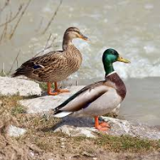






Sometimes change in the opposite direction
(Not always loss of Functional [or Phylogenetic] Diversity)

Slide 26




Slide 27

(at least) Two kinds of scale matter….
Weiher and Keddy 1995, Swenson et al. 2007

Slide 28

Comparing diversity-area relationships in forest plots….
Wang et al. 2013

Slide 29


Roles of Traits in Ecosystem Functions?

Slide 30



Slide 31


Biodiversity and Ecosystem Stability
“simple communities were more easily upset than that of richer ones; that is, more subject to destructive oscillations in populations, and more vulnerable to invasions”
C. Elton 1958
MacArthur 1955

Slide 32



More diverse communities are less stable?
Stone 2018

Slide 33


Multiple facets of biodiversity drive the diversity–stability relationship
Craven et al. 2018

Slide 34

No complexity–stability relationship in empirical ecosystems
-Jaquet et al. 2016. Nature Communications

Slide 35

Understanding diversity–stability relationships: towards a unified model of portfolio effects
Thibault and Connolly 2013

Slide 36


Stability-Scaling relationships
Wang and Loreau 2014 Ecology Letters
Wang et al. 2017 Nature Communications

Slide 37


First Biodiversity-Ecosystem Functioning (BEF) Experiment
“A greater absolute amount of life can be supported…when life is developed under many and widely different forms,…the fairest measure of the amount of life being probably the amount of chemical composition and decomposition within a given period.”

Slide 38




1990s—BEF becomes an idea

Slide 39


Ecosystem Models Ignore Species and Their Diversity

Slide 40
2010-2020s—BEF becomes a paradigm
Tilman 2014, Annu. Rev. Ecol. Evol.

Slide 41

Hooper et al. 2012

Slide 42


“We find no general tendency for local-scale plant species diversity to decline over the last century, calling into question the widespread use of ecosystem function experiments to argue for the importance of biodiversity conservation in nature.”
Vellend et al. 2013, PNAS

Slide 43



Sort of...

Slide 44



Which is cause and which is effect?
Species richness is not an ‘independent variable’
Grace et al. 2007, Ecology Letters

Slide 45

As always….scale matters
Craven et al. 2020, Global Ecology Biogeography

Slide 46


Metacommunities and BEF
Community
Assembly and the
Functioning of
Ecosystems

Slide 47



Slide 48




Slide 49




Slide 50




